Slide 1
Analyzing the Impact of Airline Loyalty Campaign on Membership & Flight Bookings

Slide 2
Brief Case of Study
The purpose of this analysis is to understand the loyalty campaign on membership and flight bookings in Canada during the period 2012-2018.

Slide 3
Tools
Python
Pandas
Matplotlib
Jupyter Notebook

Slide 4
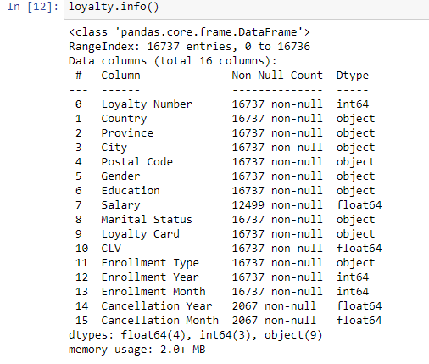
EDA / Exploratory Data Analysis
Find Unique Loyal Customer
From the above information, we can infer that there are 16737 unique loyalty customers.
Since the aim of this code is to collect data on them, let us cluster the data based on the customers only.

Slide 5
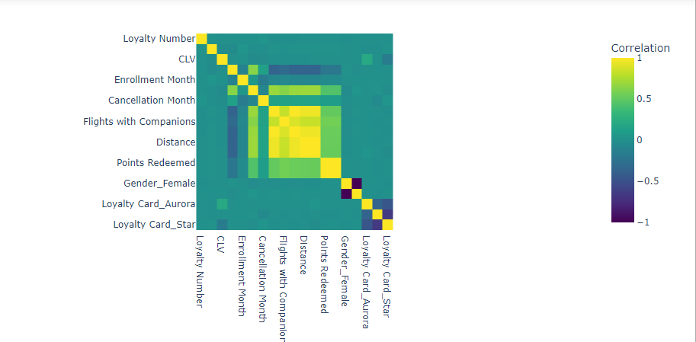
Data Processing
Creating Heatmap to understand data trends and correlations.

Slide 6
According to the heatmap, there are some observations:
Those members who have cancelled their membership have a negative trend with the number of flights and points accumulated/redeemed.
A higher value of Enrollment Year and a lower value of Cancellation Year correlates to a lower value of flights and points accumulated/redeemed.
Above two points are because their record tenure is shorter.
Points accumulated and points redeemed are in a strong positive trending correlation with flights booked. (0,5)
There is a slight correlation between Loyalty Card status and the CLV (Customer Lifetime Value). Aurora has a slight positive trend, while Star has a slight negative trend. Korelasi tipis (0,1) dan (-0,1)
One might expect there to be trends with the Gender and Salary of a Customer, but that makes no difference to any value.

Slide 7
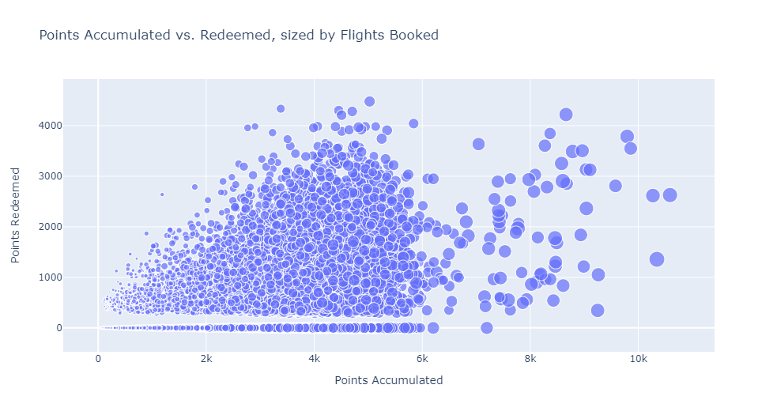
Data Visualization
Creating Scatterplot to understand the trends of accumulated points and redeemed based on flights booked

Slide 8
We can infer from the above graph that the more points are accumulated, the more flights are booked. Additionally, despite what logic dictates, it is not clear that more accumulation results to higher redemption of points.

Slide 9
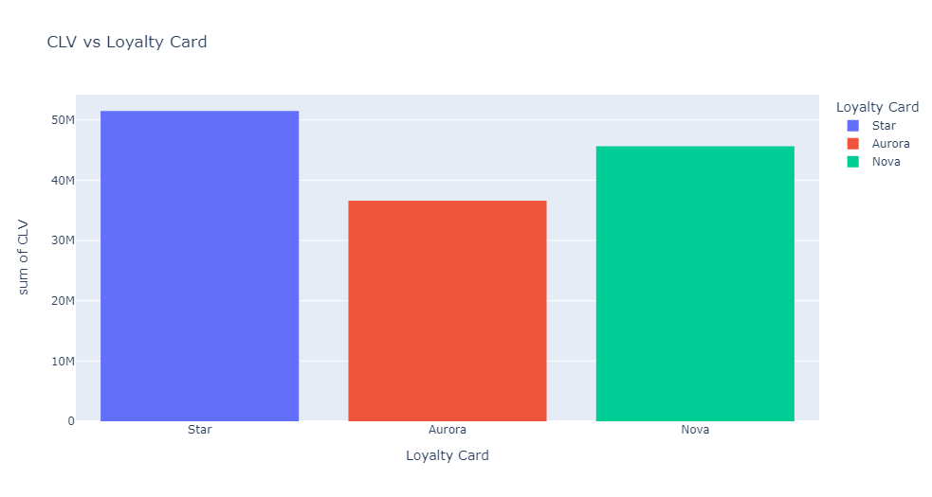
Creating bar chart to define the high value customer

Slide 10
We can see that a customer has higher value if they are from the Star Loyalty Card, then it is Nova and then it's Aurora.

Slide 11
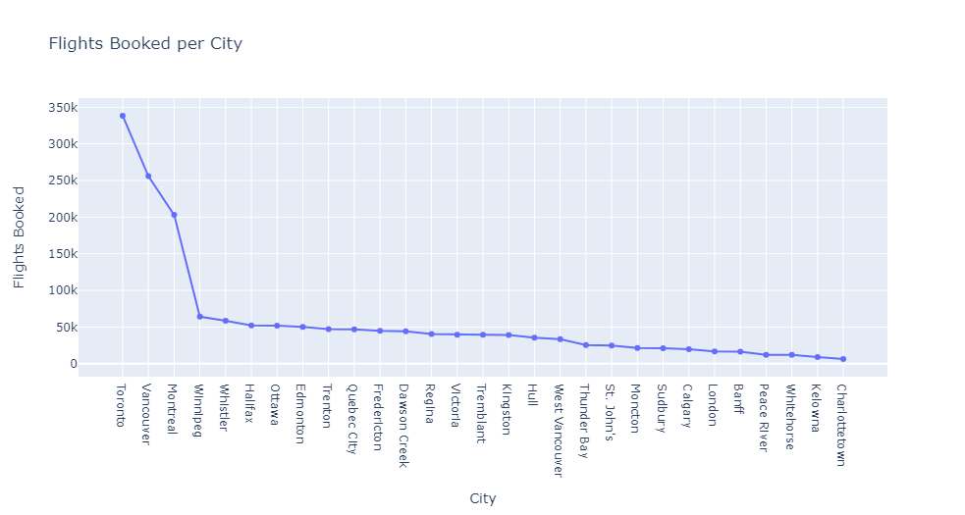
Creating line chart to define the top cities flight booked

Slide 12
The top 3 cities of Canada have the most flights booked. Toronto, Vancouver, and Montreal together booked 47.7% of all flights

Slide 13
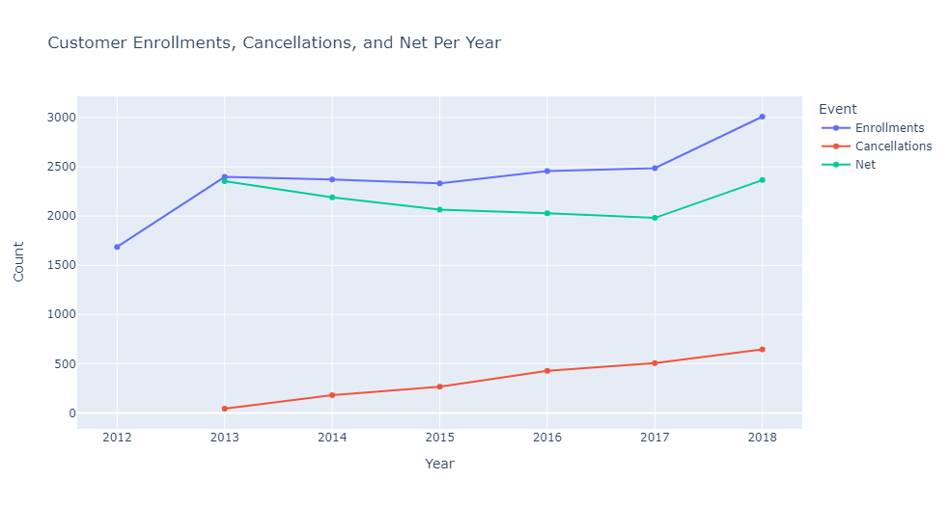
Creating line chart to define the customer churn rate

Slide 14
The customers churn positively. Despite a rising cancellation rate of customers across the years, the enrollments are in such a high number, that the net is slightly affected.
There is a profitable uptrend from 2017-18 owing to the high number of enrollments.

Slide 15
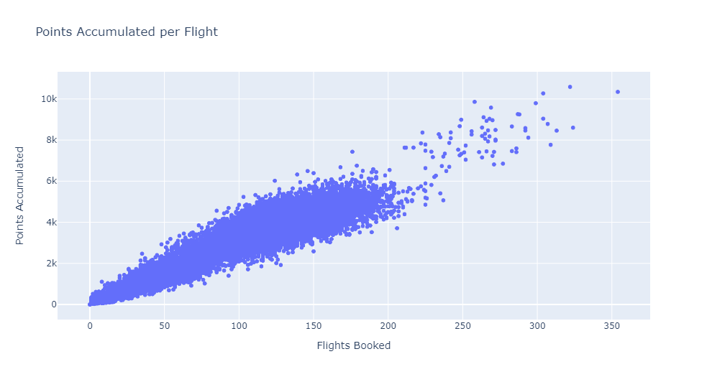
Defining points accumulated per flight

Slide 16
From the above graph, there is an increasing trend in the accumulation of data points per flight over time

Slide 17
Conclusions & Recommendations
The conclusions are
the more points are accumulated, the more flights are booked
a customer has higher value if they are from the Star Loyalty Card, then it is Nova and then it's Aurora.
The top 3 cities of Canada have the most flights booked. Toronto, Vancouver, and Montreal together booked 47.7% of all flights
There is a profitable uptrend from 2017-18 owing to the high number of enrollments.
The Recommendations are
Applying machine learning methods to create high-value customer clustering in order to provide a specific program for that cluster

Slide 18
Thank You

